Slide 1
Using R as a GIS system
Isabel Rosa
isabel.rosa@idiv.de
iDiv Summer School
22 August 2018,
Leipzig, Germany

Slide 2
Overall view of the practical
Import packages
Read in data
Check coordinates, etc.
Perform simple vector operations (merge, select)
Visualize shapefiles
Convert to raster
Visualize raster
Perform simple raster operations (cell statistics)
Combine the two (zonal, interporlation)
Export output
Exercise
yDiv Introduction to GIS and Spatial Analysis
5-9th November 2018

Slide 3
Spatial Data Packages in R
We‘ll be using mainly these three:
sp: to work with vector data
raster: to work with raster data
rgdal: to import/export and perform other operations with spatial data in R
For those using GitHub: https://github.com/isabel-rosa/R_as_GIS.git

Slide 4
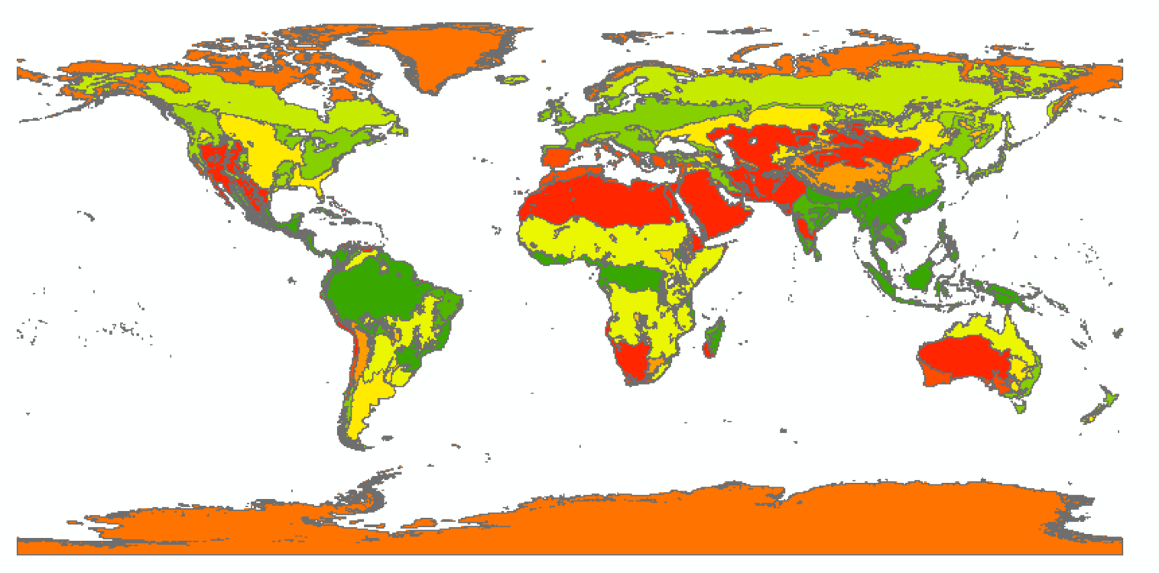
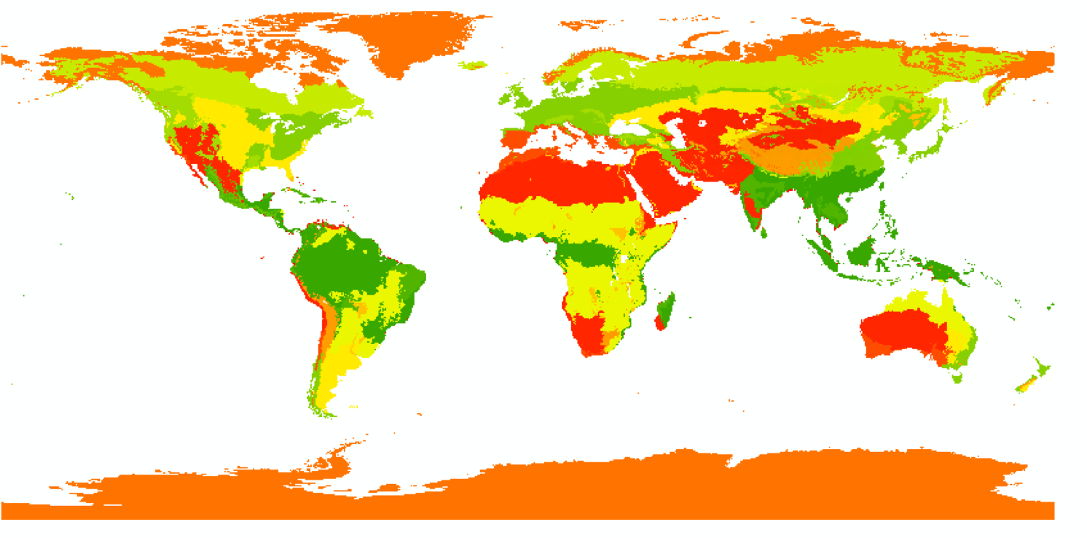
Shapefiles and Rasters
A shapefile stores the geometric location and attribute information of geographic features. These can be represented by points, lines, or polygons (areas).
A raster consists of a matrix of cells (or pixels) organized into rows and columns (or a grid) where each cell contains a value representing information. They can be categorical or continuous and have multiple bands.
Notes:
Use world map shapefile as example (vector with attribute table, raster, and then an image with three bands)

Slide 5
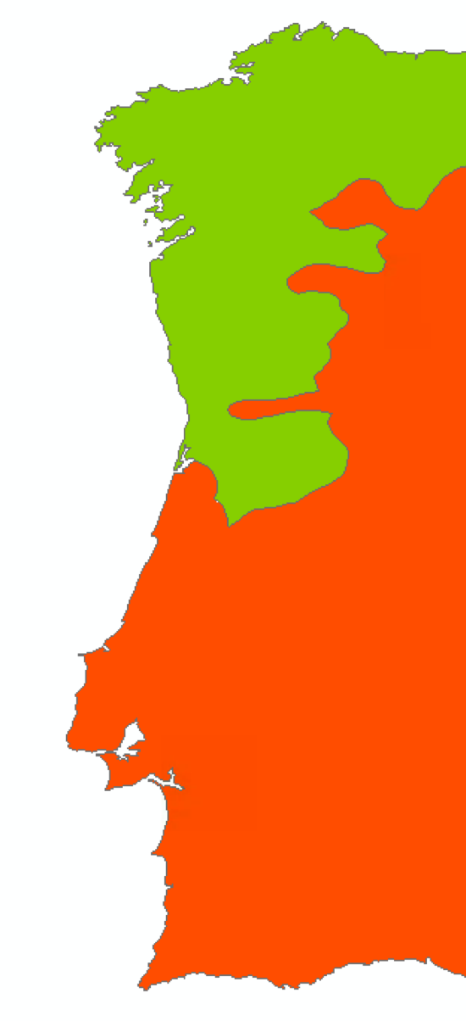

Shapefiles and Rasters
The raster will look very different if you use a coarse resolution (0.25 degrees), but increase a lot in size if you use a high resolution (30 m)
A shapefile can contain a lot of information associated to the geographic features, whereas the raster, in each band, contains one single value per pixel
Notes:
Use world map shapefile as example (vector with attribute table, raster, and then an image with three bands)

Slide 6
Importing and visualizing data in R
Markdown
Data for today‘s exercise:
http://earthenginepartners.appspot.com/science-2013-global-forest

Slide 7
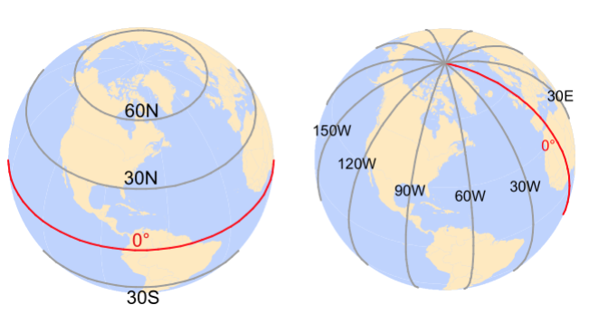
Coordinate Systems
A coordinate system is a reference system used to represent the locations of geographic features, imagery, and observations such as GPS locations within a common geographic framework.
A global or spherical coordinate system such as latitude–longitude. These are often referred to as geographic coordinate systems. E.g. WGS84
A projected coordinate system based on a map projection such as transverse Mercator and Albers equal area, all of which provide various mechanisms to project maps of the earth's spherical surface onto a two-dimensional Cartesian coordinate plane. Projected coordinate systems are sometimes referred to as map projections. E.g. UTM zones

Slide 9
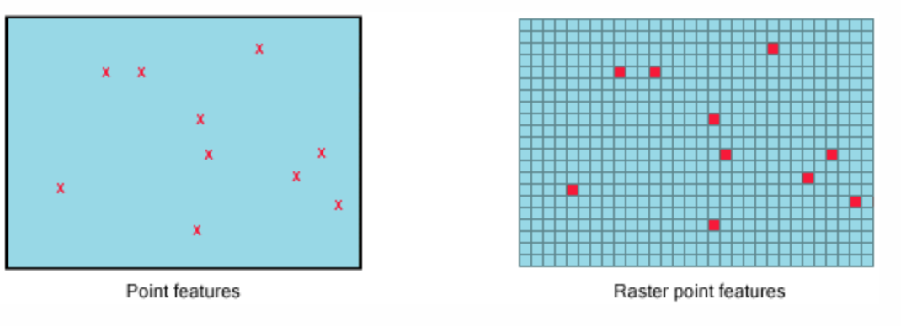
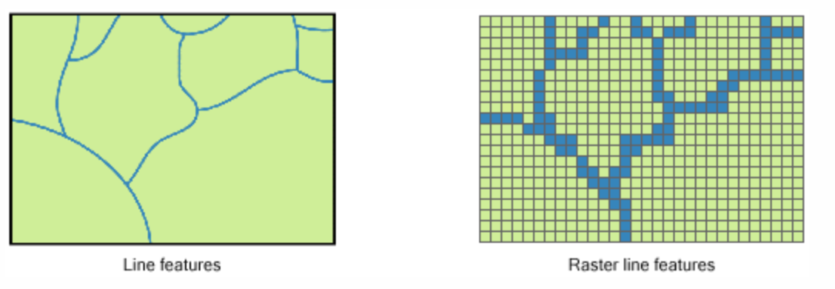
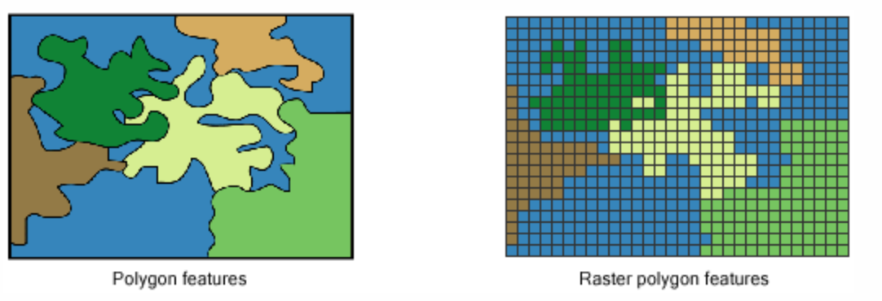
Transform your input data
Converting shapefile to raster
Which data?
To what extent?
Using which resolution?

Slide 10
Operations with shapefiles
There is a large number of operations that you can perform using shapefiles, just some examples:
Selection by attributes
Merge and Intersect
Clip and Erase
Aggregate/Dissolve

Slide 11
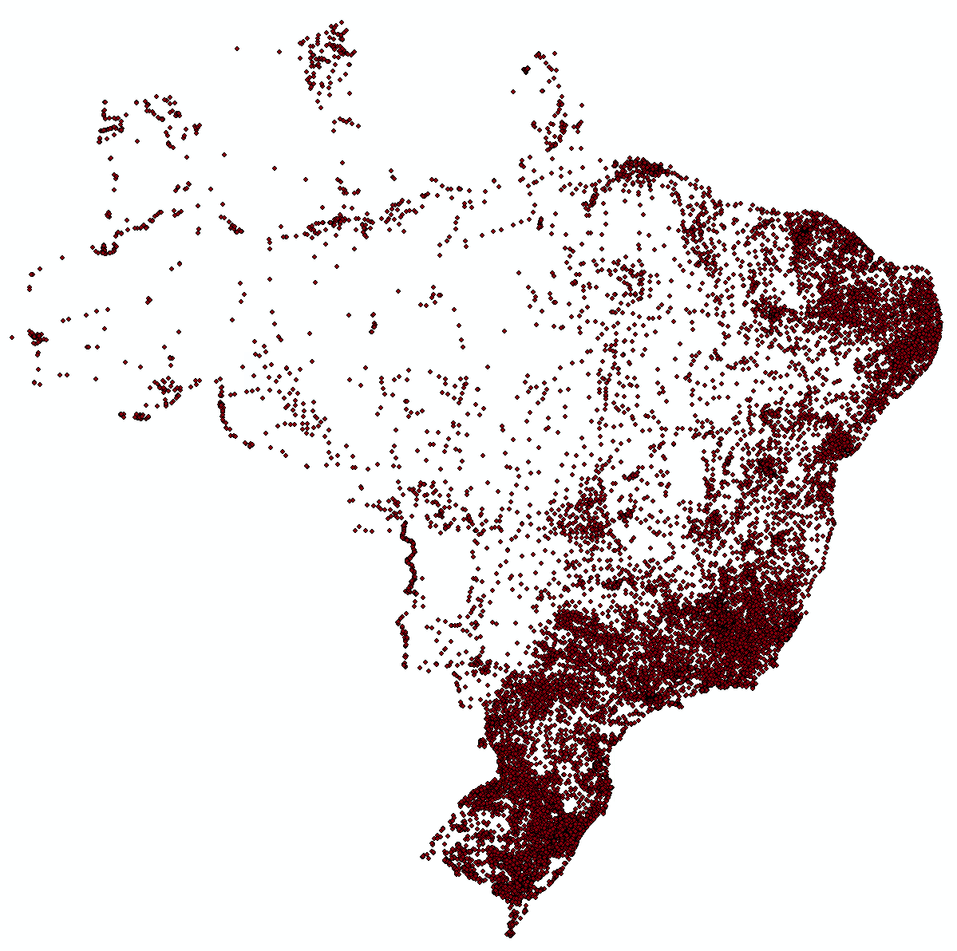
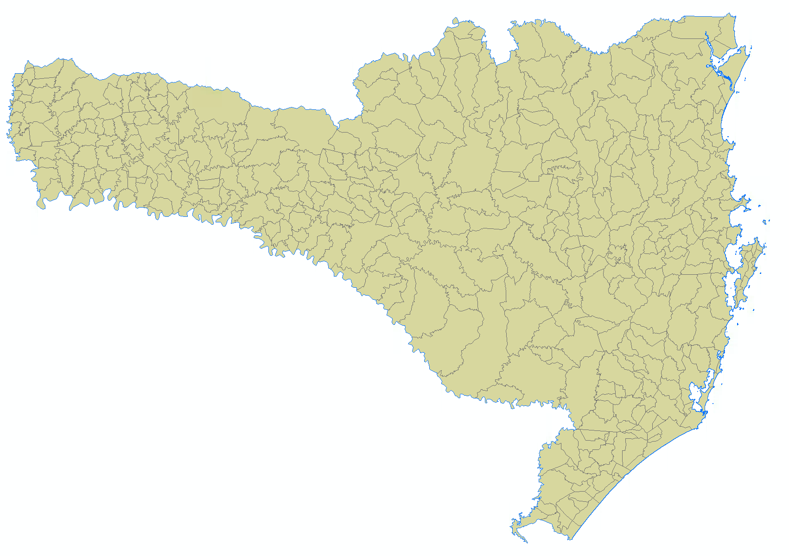
Working with shapefiles in R
Markdown
http://www.rspatial.org/spatial/rst/7-vectmanip.html

Slide 12
Operations with rasters (map algebra)
Operations with rasters are extremely powerful and can be done:
Globally: considering all raster values
Locally: on a pixel by pixel basis
Focal: considering the neighboorhood
Zonal: considering zones
Cell statistics
Focal statistics
Sum = 19

Slide 13
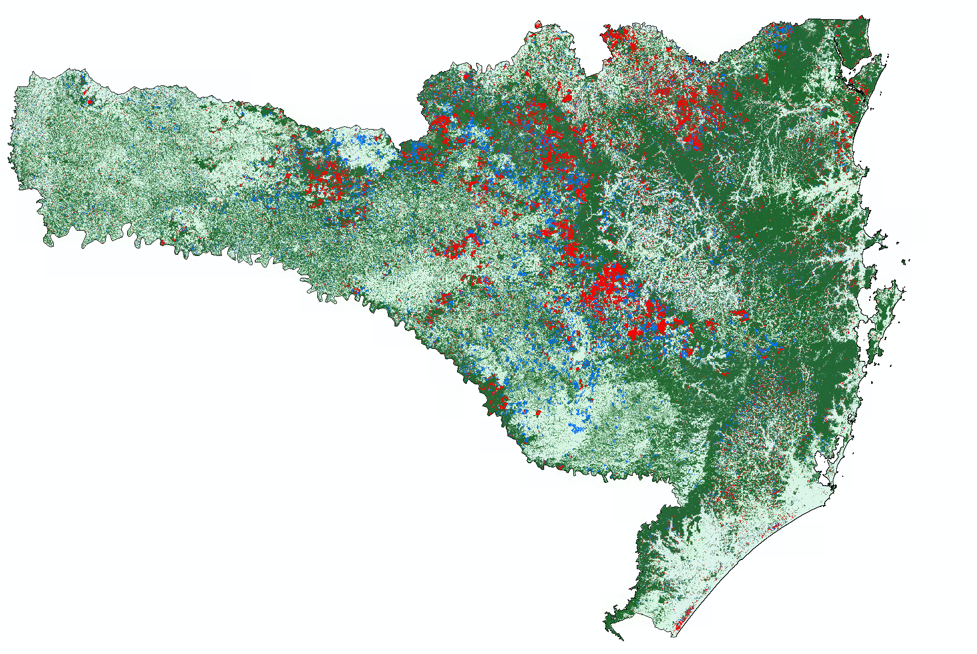
Working with rasters in R
Markdown
http://www.rspatial.org/spatial/rst/8-rastermanip.html
http://earthenginepartners.appspot.com/science-2013-global-forest
Tree cover (%) in 2000
Loss and Gain 2000-2014

Slide 14
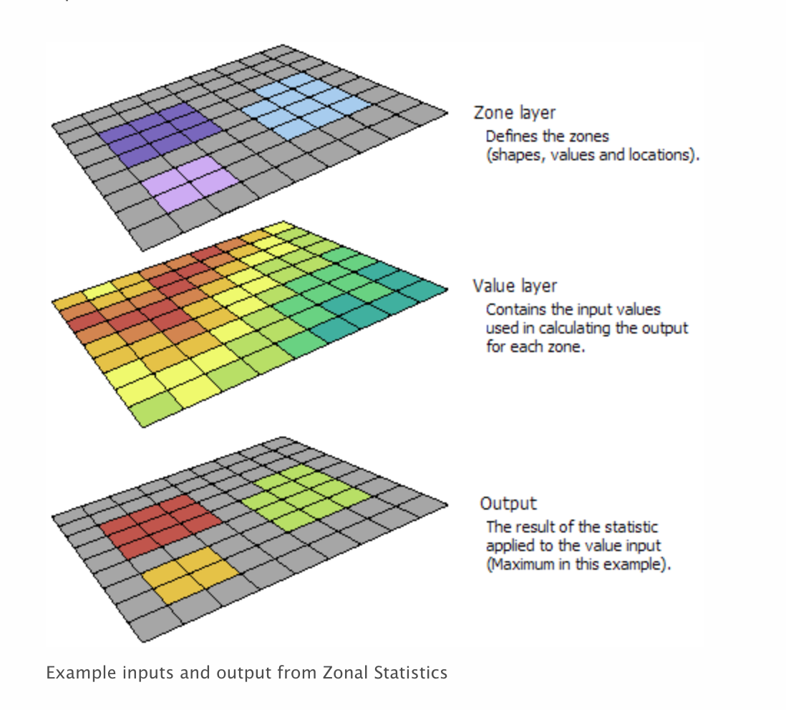
Mixing both
Zonal Statistics: get aggreagted statistics per previously defined zones (shapefile or raster)
Distances: calculates minumum distance from each pixel to the nearest feature. Useful to calculate, for instance, distance to roads, rivers, settlements, etc.
Interpolation: spatial autocorrelation
Tobler’s First Law of Geography
(Waldo R. Tobler’s in 1969)
Everything is related to everything else, but near things are more related than distant things.

Slide 15
Interpolation: a world in itself IDW, Spline and Krigging

Slide 16
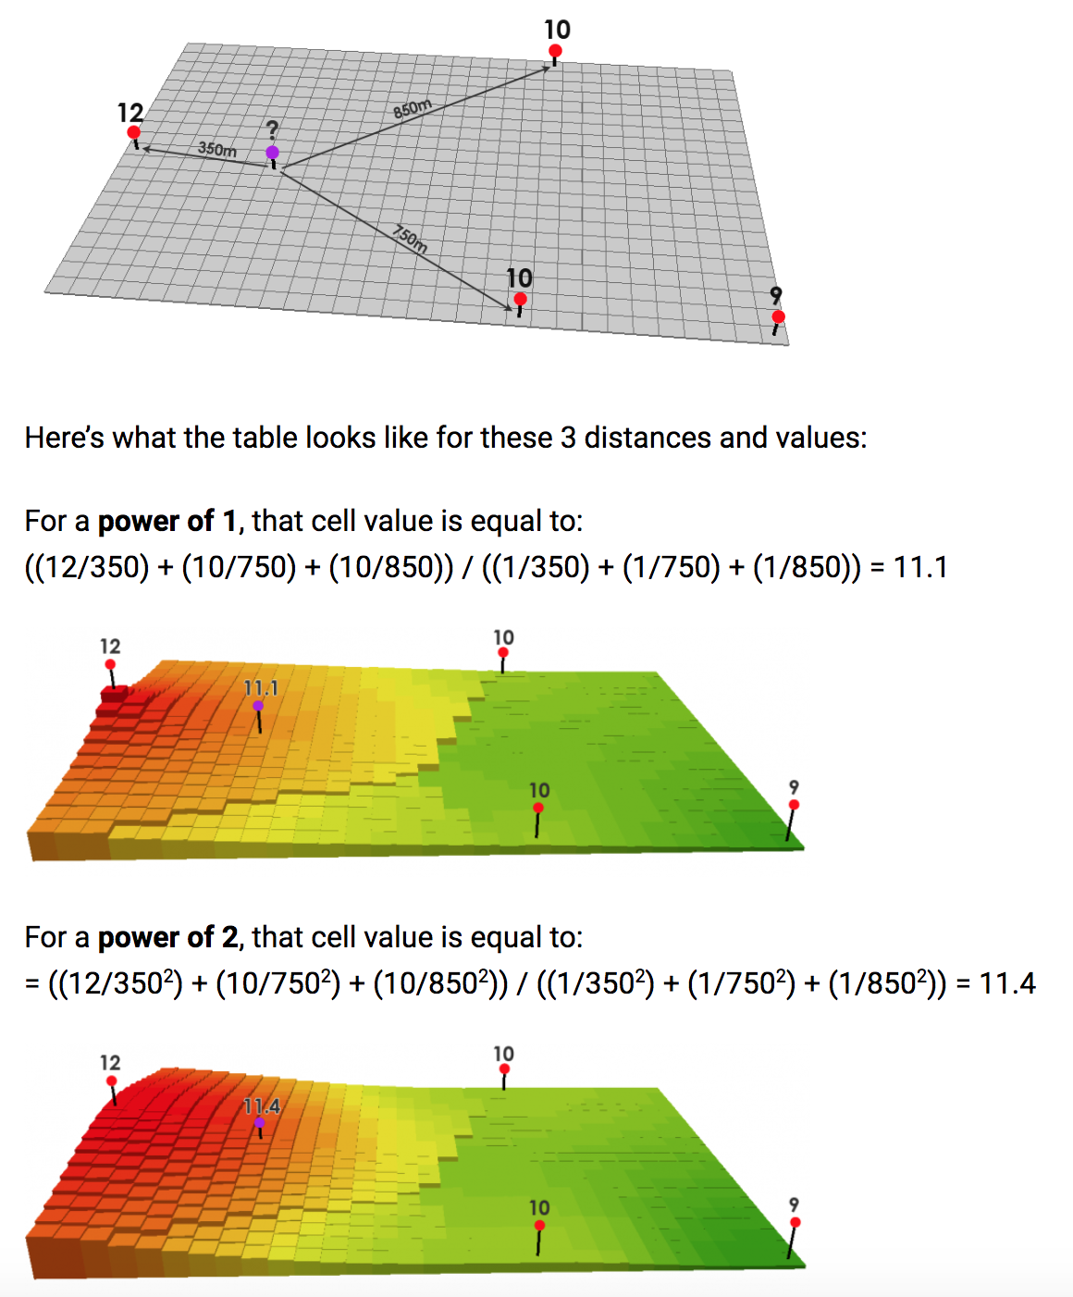
IDW
Interpolates a raster surface from points using an inverse distance weighted (IDW) technique.
IDW relies mainly on the inverse of the distance raised to a mathematical power.
The Power parameter lets you control the significance of known points on the interpolated values based on their distance from the output point. It is a positive, real number, and its default value is 2.
By defining a higher power value, more emphasis can be put on the nearest points. Thus, nearby data will have the most influence, and the surface will have more detail.

Slide 17
Working with rasters and shapefiles in R
Markdown

Slide 18
Exporting spatial data from R
Exporting shapefile
# Save polygon layer to shapefile
writeOGR(s1, dsn=".", layer="Counties", driver="ESRI Shapefile" )
outfile <- 'test.shp' shapefile(s, outfile, overwrite=TRUE)
# Save point layer to shapefile
writeOGR(pt2, dsn=".", layer="Colleges", driver="ESRI Shapefile" )
Exporting raster
writeRaster(r1, filename="elev", format="GTiff" )

Slide 19
Questions?
Main Resources:
http://www.rspatial.org/spatial/
https://mgimond.github.io/Spatial/index.html
Other Resources:
http://zevross.com/blog/2016/01/13/tips-for-reading-spatial-files-into-r-with-rgdal/
https://www.jessesadler.com/post/gis-with-r-intro/
https://edzer.github.io/UseR2017/

Slide 20
Exercise
Go to course folder or GitHub
Download data
Download markdown
Start working through the exercise
If you get stuck, please ask
In the end you can check my solution
If you end early, you can always look through the references or try using what you‘ve learned on your own spatial data.

